Slide 1
Git: a distributed version control system
Dr. Chang Liu

Slide 2

SCM: Source Code Management Systems
Version control
  Revisions
  Change sets
  Branches
Conflict detection
  Conflicts
  Conflict resolution and code merging

Slide 3
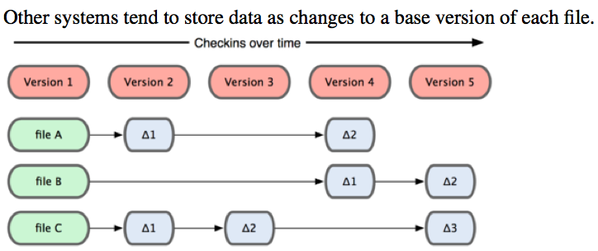
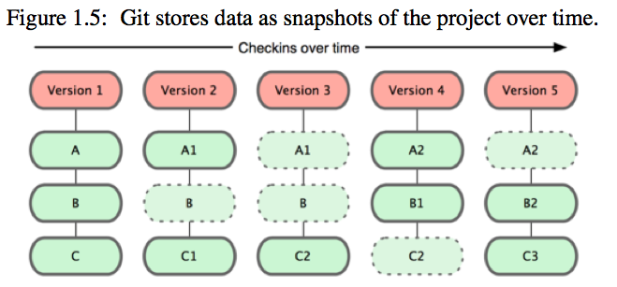
Comparison with CVS/Subversion
CVS/Subversion: Differences
Git: Snapshots
Git tracks contents, not files, hence the slight difference in the semantics of the “add” command.

Slide 4
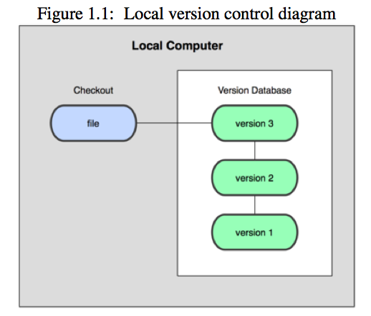
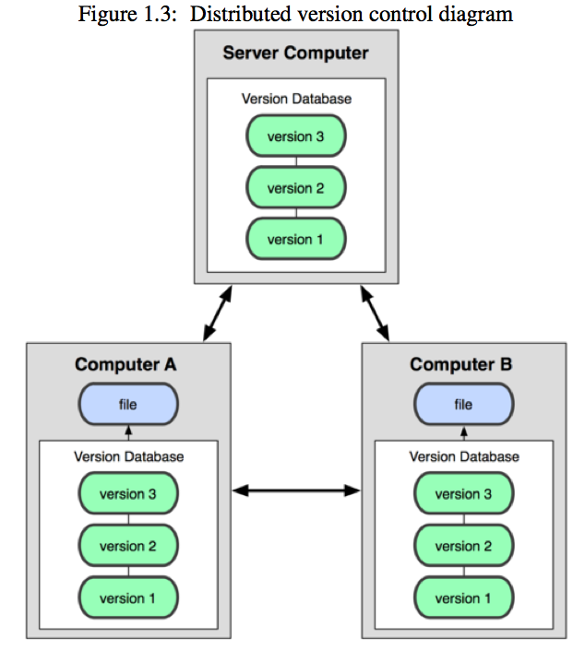
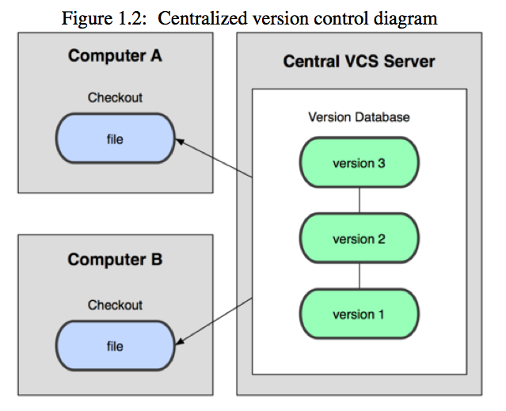
Distributed version control systems
Figures are from the “Pro GIT” book and the “GIT Community Book.”

Slide 5
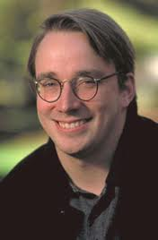
History of Git
DVCS Bitkeeper
2005, started by Linus Torvalds
Man page: "git - the stupid content tracker”
Design goals:
  Speed
  Simple design
  Strong support for non-linear development (thousands of parallel branches)
  Fully distributed
  Able to handle large projects like the Linux kernel efficiently (speed and data size)

Slide 6
Git features
Each developer gets a local copy of the repository
  Changes are copied from one repository to another
  Changes are imported as branches that can be merged
Repositories are accessed via
  the Git protocol (could be wrapped in ssh)
  Or via the web
Supports quick and convenient branching and merging in non-linear development
Every Git clone is a full-fledged repository with complete history and full revision tracking capabilities, not dependent on network access or a central server.

Slide 7
Projects Using Git
Linux Kernel
  http://git.kernel.org/?p=linux/kernel/git/torvalds/linux- 2.6.git
Android – An Open Handset Alliance Project
  http://android.git.kernel.org/
Android (Google's smartphone OS)
  http://source.android.com/
Perl, Eclipse, OpenSim, Gnome, KDE, Qt, Ruby on Rails, PostgreSQL, …
More here
  https://git.wiki.kernel.org/index.php/GitProjects

Slide 8
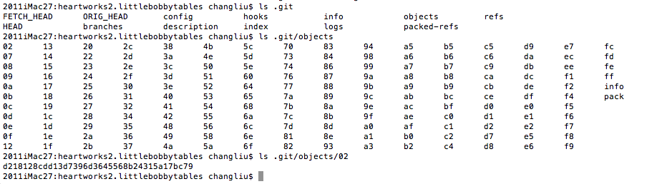
.git directory and SHA
One .git per repository (not one per folder)
40-digit “object name” (SHA-I hash, a cryptographic hash function, published by NIST in 1995, designed by NSA)

Slide 9
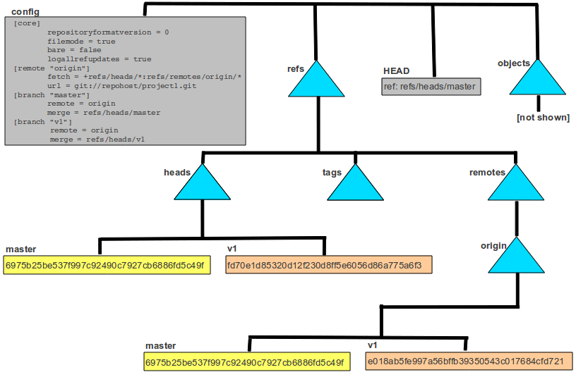
.git directory

Slide 10
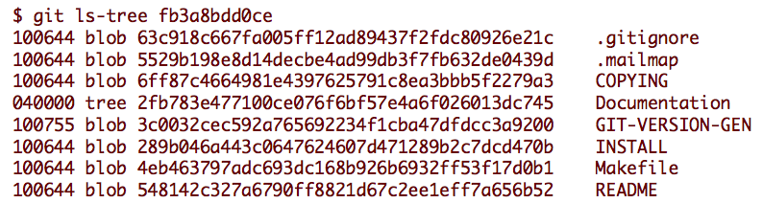
Git objects
Type
  Blob
  Tree
  Commit
  Tag
Size
Content

Slide 11
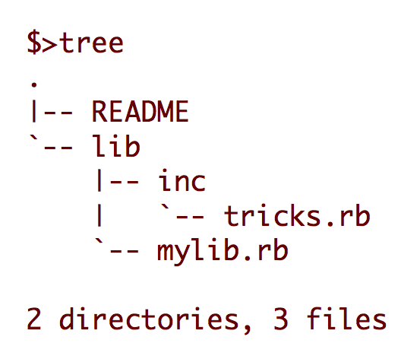
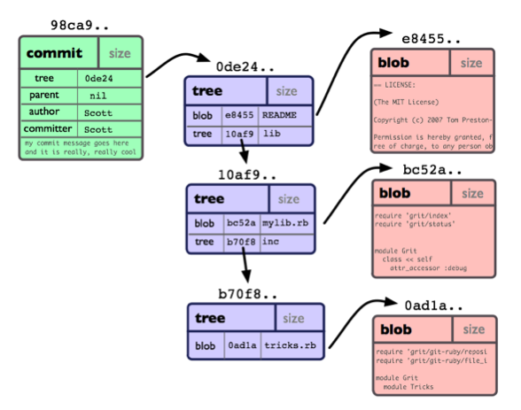
Git object model

Slide 12
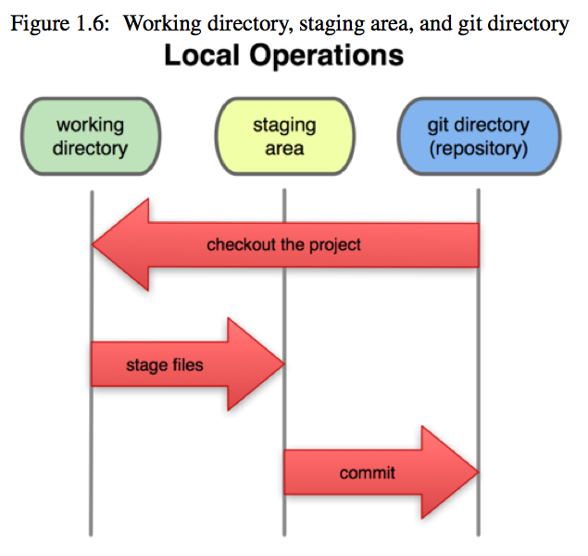
Working directory, staging area, and Git repository
remote
git repository
clone
$ git push
$ git pull
$ git fetch
$ git commit
$ git checkout
$ git add
push
fetch
pull

Slide 13
“Hello World!”
$ mkdir /path/to/your/project
$ cd /path/to/your/project
$ git init
$ git remote add origin ssh://git@bitbucket.org/liuc/cs3560.test.git
$ echo "# This is my README" >> README.md
$ git add README.md
$ git commit -m "First Commit. Adding a README."
$ git push -u origin master
$ echo "# Hello World!" >> README.md
$ git add README.md
$ git commit -m “Adding Hello World."
$ git push

Slide 14

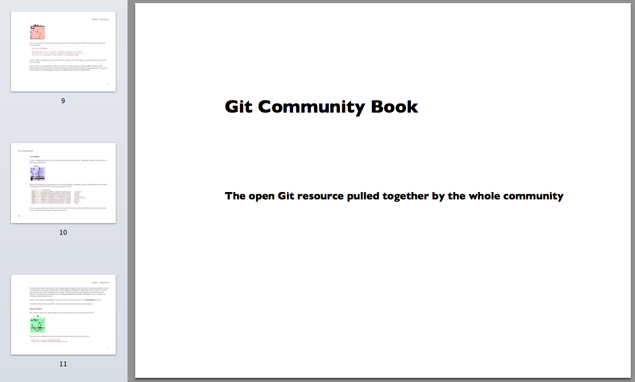
Git tutorials
http://www.kernel.org/pub/software/scm/git/docs/gittutorial.html

Slide 15
Issues to consider before adoption
Sustainability: Git will never go away. (It’s open source.)
Performance: is one of Git’s strength
Pricing: free; (Git repository hosting may not be free.)
Compatibility: Good. (e.g. Xcode integration)
Benefit/cost analysis: There is a learning curve, but SCM is necessary in virtually all projects. Git is one of the best SCM.
Maintenance: fully encapsulated in the git command and easy to upgrade without breaking tool chains

Slide 16
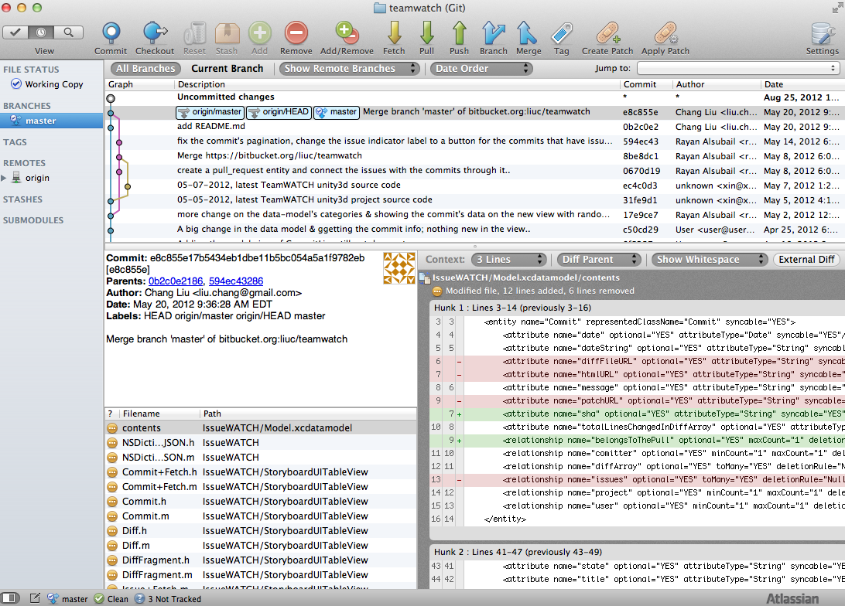
Git GUI Clients
SourceTree (Mac)
TortoiseGit
…

Slide 17
Frequently used git commands
$ git checkout
$ git log --stat
$ git status
$ git clone
$ git branch
$ git reset
$ git remote add origin ssh://git@bitbucket.org/liuc/cs3560.test.git
$ git add
$ git commit -m ”Log message."
$ git push
$ git pull
$ git fetch

Slide 18
Typical git workflow
$ git checkout or $ git clone
// Update or add files
$ git add
$ git status
$ git commit -m ”log message.” or $ git reset
$ git push
$ git pull
$ git log --stat
$ git branch

Slide 19
Git config
2011macbookair11:gitwork changliu$ git config --global –l
user.name=Chang Liu
user.email=liu.chang@gmail.com
color.ui=auto
color.branch=auto
color.status=auto
color.interactive=auto
branch.autosetupmerge=true
2011macbookair11:gitwork changliu$

